Slide 1
Setting up DNN

Slide 2

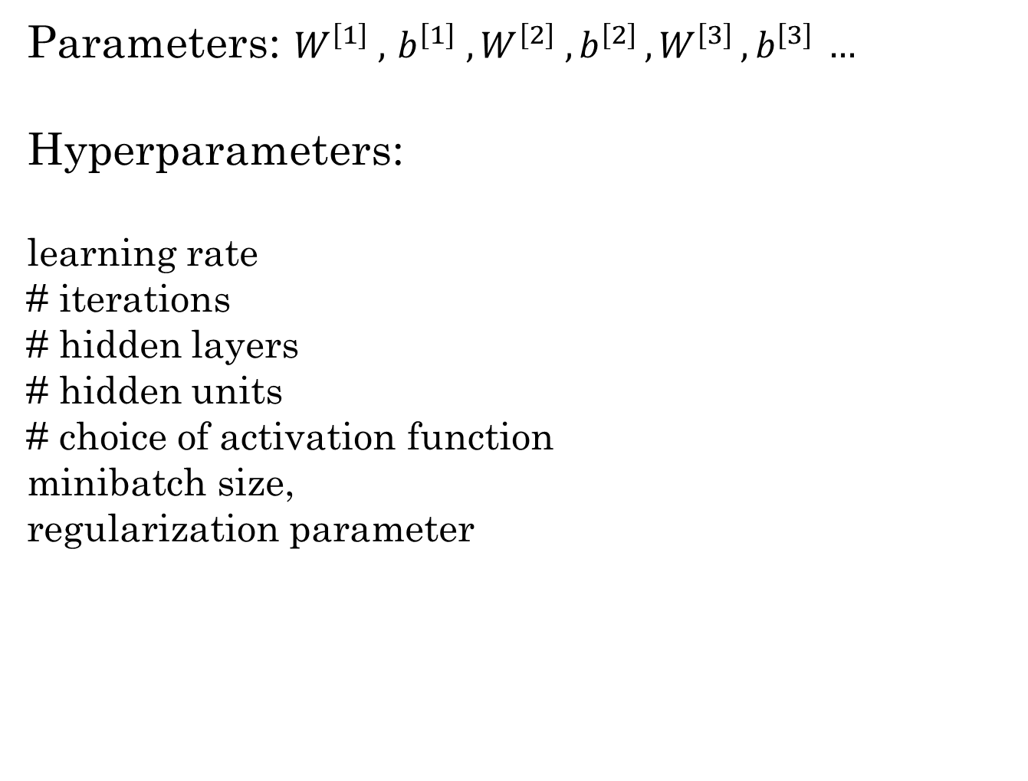
Applied ML is a highly iterative process
Parameters: $W^{\left[1\right]} ,{ b}^{\left[1\right] }, W^{\left[2\right]} ,b^{\left[2\right] },W^{\left[3\right] }, b^{\left[3\right] }…$
Hyperparameters:
learning rate
# iterations
# hidden layers
# hidden units
# choice of activation function
minibatch size,
regularization parameter
Idea
Experiment
Code
NLP, Computer Vision, Speech Recognition, Structured data (Ads, Search, Security, logistic...)

Slide 3
Training/Development/test sets
A training dataset is a dataset of examples used for learning which machine learning algorithm “learns,” relationships between the features and the target variable.
A validation dataset is a dataset of examples used to tune the hyperparameters (i.e. the architecture) of a classifier. It is sometimes also called the development set (“dev set”) or hold-out cross validation set.
A test dataset is a dataset that is independent of the training dataset, but that follows the same probability distribution as the training dataset. Test set used to evaluate the performance of the algorithm, but not to make any decisions regarding what learning algorithm or parameters to use.
wikipedia.org

Slide 4
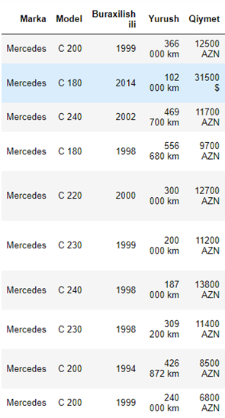
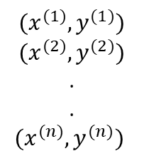
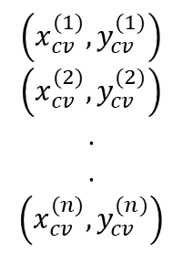
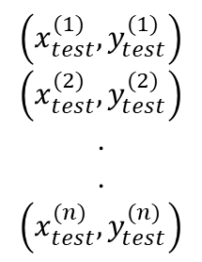
$${(x}^{(1)},y^{(1)})$$
$${(x}^{(2)},y^{(2)})$$
.
.
$${(x}^{(n)},y^{(n)})$$
Train/dev/test sets
Dataset:
$$\left(x_{cv}^{(1)},y_{cv}^{(1)}\right)$$
$$\left(x_{cv}^{(2)},y_{cv}^{(2)}\right)$$
.
.
$$\left(x_{cv}^{(n)},y_{cv}^{(n)}\right)$$
Small Data
Train: 60%
Dev Set: 20%
Test: 20%
$$\left(x_{test}^{(1)},y_{test}^{(1)}\right)$$
$$\left(x_{test}^{(2)},y_{test}^{(2)}\right)$$
.
.
$$\left(x_{test}^{(n)},y_{test}^{(n)}\right)$$
Big Data:
Train: 98%
Dev Set: 1%
Test: 1%
Train: 99%
Dev Set: 0.5%
Test: 0.5%
Big Data: 1000 000
10 000 (dev), 10 000(test)

Slide 5
Mismatched train/test distribution
Training set:
Cat pictures from webpages
Dev/test sets:
Cat pictures from users using your app
Make sure "dev" and test come from same distribution
Not having a test set might be okay. (Only dev set.)

Slide 6
Generalization, Overfitting, Underfitting.
Generalization is the model’s ability to give sensible outputs to sets of input that it has never seen before.
Overfitting is the case where the overall cost is really small, but the generalization of the model is unreliable. This is due to the model learning “too much” from the training data set.
Underfitting is the case where the model has “ not learned enough” from the training data, resulting in low generalization and unreliable predictions.
https://towardsdatascience.com/what-are-overfitting-and-underfitting-in-machine-learning-a96b30864690

Slide 7
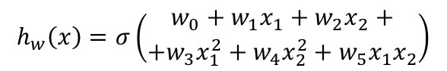
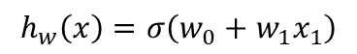
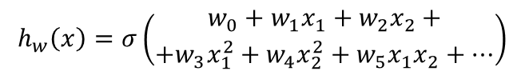
Example: Logistic regression
x₂
x₂
x₂
x₁
x₁
x₁
$$h_{w}\left(x\right)=σ\left(w_{0}+w_{1}x_{1}\right)$$
$$h_{w}\left(x\right)=σ\left(\begin{aligned}w_{0}+w_{1}x_{1}+w_{2}x_{2}+ \\ +{w_{3}x}_{1}^{2}+{w_{4}x}_{2}^{2}+w_{5}x_{1}x_{2}\end{aligned}\right)$$
$$h_{w}\left(x\right)=σ\left(\begin{aligned}w_{0}+w_{1}x_{1}+w_{2}x_{2}+ \\ +{w_{3}x}_{1}^{2}+{w_{4}x}_{2}^{2}+w_{5}x_{1}x_{2}+…\end{aligned}\right)$$
“Underfit”
“Overfit”
Overfitting: If we have too many features, the learned hypothesis may fit the training set very well (J(w)≈0 ), but fail to generalize to new examples.

Slide 8
Bias and Variance
$$y=1$$
$$y=0$$
Cat classification
Train set error:
$$15\%$$
$$16\%$$
$$15\%$$
$$30\%$$
$$0.5\%$$
$$1\%$$
$$1\%$$
$$11\%$$
Dev set error:
high variance
high bias
high bias &
high variance
low bias &
low variance
Humans: $≈0\%$
Optimal (Bayes) error: $≈0\%$
Bayes error rate is the lowest possible error rate for any classifier of a random outcome (into, for example, one of two categories) and is analogous to the irreducible error

Slide 9
High bias and high variance
$$x_{2}$$
$$x_{1}$$

Slide 10
High bias and high variance
$$x_{2}$$
$$x_{1}$$

Slide 11
Basic recipe for machine learning
YES
Bigger network
Train longer
(NN architecture search)
High bias?
(training data performance)
NO
More data
Regularization
(NN architecture search)
High variance?
(dev set performance)
YES
NO
“Bias variance tradeoff”
Done

Slide 12
Regularization

Slide 13
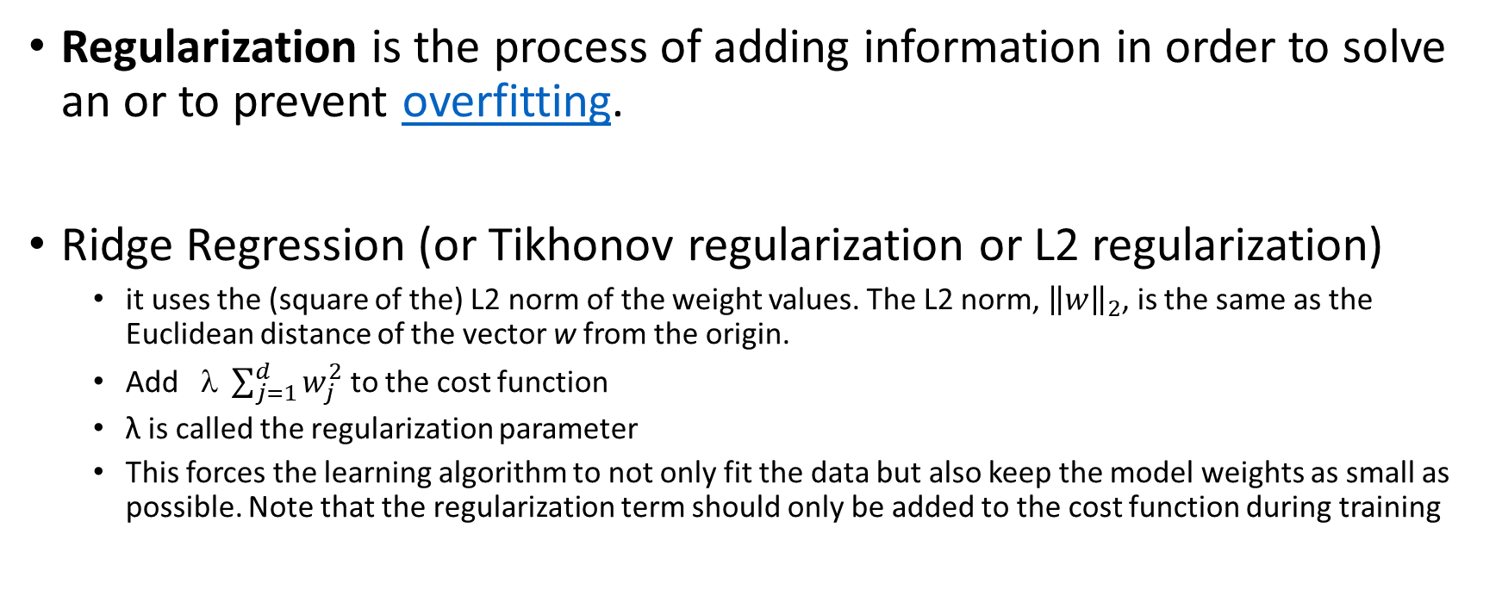
Regularization
Regularization is the process of adding information in order to solve an or to prevent overfitting.
Ridge Regression (or Tikhonov regularization or L2 regularization)
it uses the (square of the) L2 norm of the weight values. The L2 norm, ${\left\|w\right\|}_{2}$, is the same as the Euclidean distance of the vector w from the origin.
Add $ \sum_{j=1}^{d}{w_{j}^{2}}$ to the cost function
λ is called the regularization parameter
This forces the learning algorithm to not only fit the data but also keep the model weights as small as possible. Note that the regularization term should only be added to the cost function during training
https://en.wikipedia.org/wiki/Regularization_(mathematics)

Slide 14
Neural network
$$J\left(w^{[1]},b^{[1]},…,w^{[L]},b^{[L]}\right)=\frac{1}{m}\sum_{i=1}^{m}{ℒ\left({\hat{y}}^{\left(i\right)},y^{\left(i\right)}\right)}+\frac{λ}{2m}\sum_{l=1}^{L}{{\left\|w^{[l]}\right\|}_{F}^{2}}$$
$${\left\|w^{[l]}\right\|}_{F}^{2}=\sum_{i=1}^{n^{[l]}}{\sum_{j=1}^{n^{[l−1]}}{{\left(w_{ij}^{[l]}\right)}^{2}}}$$
“Frobenius norm”
$$w^{[l]}:\left(n^{[l]},n^{[l−1]}\right)$$
$$dw=(from backpropagation)+\frac{λ}{m}w^{[l]}$$
$$w^{[l]}≔w^{\left[l\right]}−αdw^{\left[l\right]}$$
$$w^{[l]}≔w^{\left[l\right]}−α\left[\left(from backpropagation\right)+\frac{λ}{m}w^{\left[l\right]}\right]=$$
$${=w}^{\left[l\right]}−\frac{αλ}{m}w^{\left[l\right]}−α\left(from backpropagation\right)=$$
$$=\left(1−\frac{αλ}{m}\right)w^{\left[l\right]}−α\left(from backpropagation\right)$$
$$\frac{∂J}{∂w^{[l]}}=dw^{[l]}$$
“Weight decay”
The Frobenius norm is an extension of the Euclidean norm to${ R}^{nxn}$

Slide 15
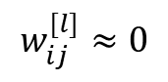
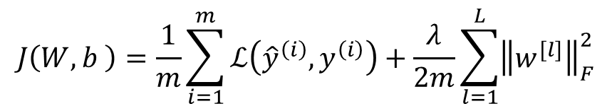
How does regularization prevent overfitting?
$$x_{1}$$
$$J\left(W,b \right)=\frac{1}{m}\sum_{i=1}^{m}{ℒ\left({\hat{y}}^{\left(i\right)},y^{\left(i\right)}\right)}+\frac{λ}{2m}\sum_{l=1}^{L}{{\left\|w^{[l]}\right\|}_{F}^{2}}$$
$$x_{2}$$
$$\hat{y}$$
$$x_{3}$$
$$w_{ij}^{[l]}≈0$$
$$x_{4}$$
x₂
x₂
x₂
x₁
x₁
x₁

Slide 16
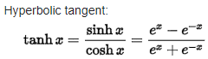
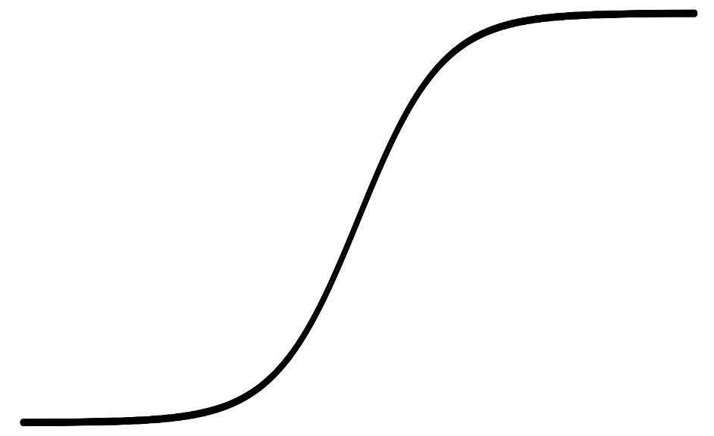
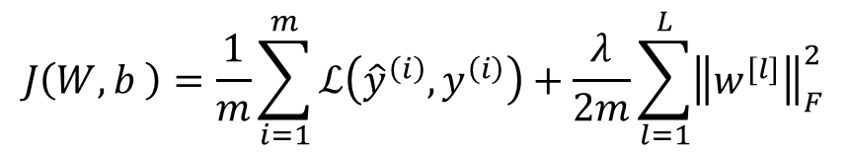
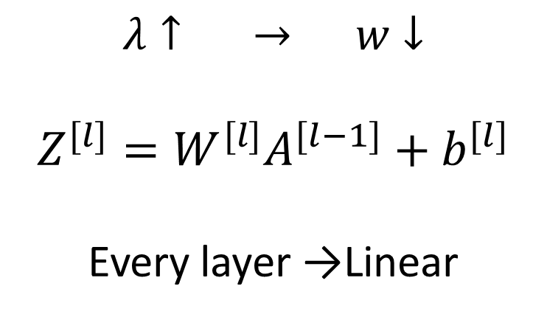
How does regularization prevent overfitting?
$$J\left(W,b \right)=\frac{1}{m}\sum_{i=1}^{m}{ℒ\left({\hat{y}}^{\left(i\right)},y^{\left(i\right)}\right)}+\frac{λ}{2m}\sum_{l=1}^{L}{{\left\|w^{[l]}\right\|}_{F}^{2}}$$
a
$$λ↑ → w↓$$
$$Z^{[l]}=W^{[l]}A^{[l−1]}+b^{[l]}$$
Every layer →Linear
z

Slide 17
Dropout regularization
$$x_{1}$$
$$x_{1}$$
$$x_{2}$$
$$x_{2}$$
$$\hat{y}$$
$$\hat{y}$$
$$x_{3}$$
$$x_{3}$$
$$x_{4}$$
$$x_{4}$$
Nitish Srivastava, et. al. Dropout: A Simple Way to Prevent Neural Networks from Overfitting

Slide 18
Implementing dropout (“Inverted dropout”)
keep_prob=0.8
Illustrate with layer l=3
d3=np.random.rand(a3.shape[0], a3.shape[1]) < keep_prob
a3=np.multiply(a3, d3) #a3*=d3
a3/=keep_prob
50 units 10 units shut off
$$z^{[4]}=w^{[4]}∗a^{[3]}+b^{[4]}$$
reduced by 20%
Making predictions at test time (No drop out)

Slide 19
Why does drop-out work?
Intuition: Can’t rely on any one feature, so have to
spread out weights.
$$x_{1}$$
$$x_{2}$$
$$\hat{y}$$
1.0
$$x_{3}$$
1.0
Downside: J doesn't decrease in every iteration
0.7
1.0
0.7
0.5

Slide 20
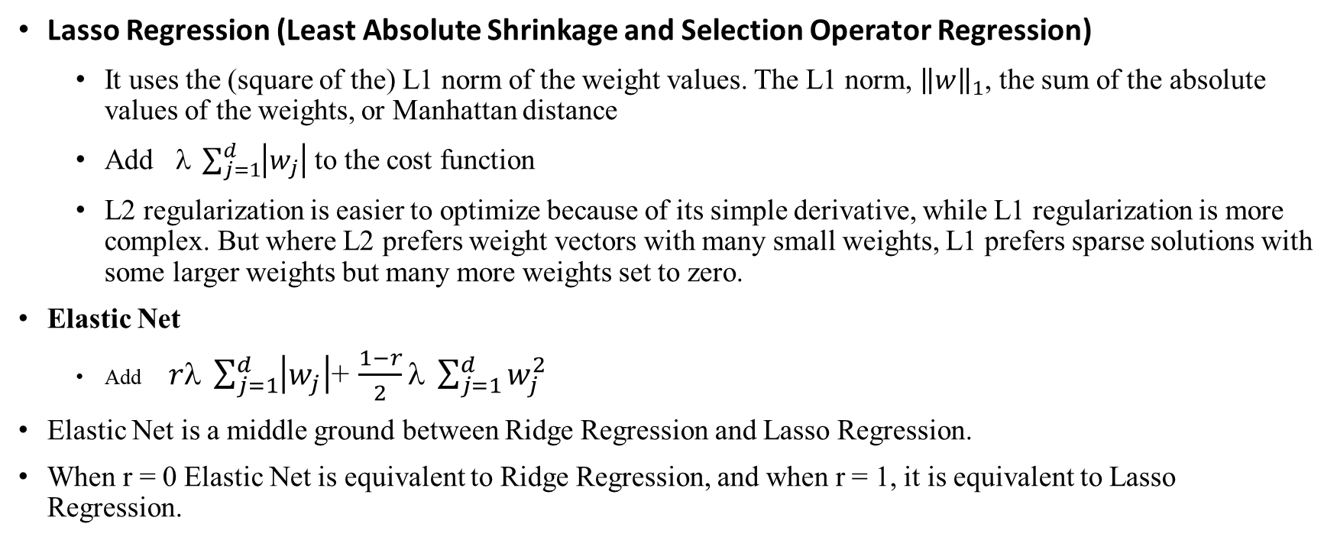
Regularization (other)
Lasso Regression (Least Absolute Shrinkage and Selection Operator Regression)
It uses the (square of the) L1 norm of the weight values. The L1 norm, ${\left\|w\right\|}_{1}$, the sum of the absolute values of the weights, or Manhattan distance
Add $ \sum_{j=1}^{d}{\left|w_{j}\right|}$ to the cost function
L2 regularization is easier to optimize because of its simple derivative, while L1 regularization is more complex. But where L2 prefers weight vectors with many small weights, L1 prefers sparse solutions with some larger weights but many more weights set to zero.
Elastic Net
Add$rλ \sum_{j=1}^{d}{\left|w_{j}\right|}$+ $\frac{1−r}{2}λ \sum_{j=1}^{d}{w_{j}^{2}}$
Elastic Net is a middle ground between Ridge Regression and Lasso Regression.
When r = 0 Elastic Net is equivalent to Ridge Regression, and when r = 1, it is equivalent to Lasso Regression.

Slide 21
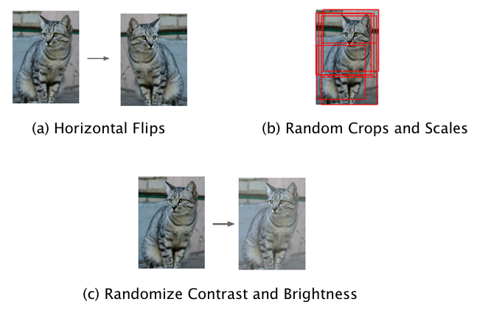
Training Data Augmentation
A simple technique to get around this problem is by artificially expanding the training set.
Transformation
Translation: Moving the image by a few pixels in various directions
Rotation
Reflection
Skewing
Scaling: Changing the size of the image while preserving its shape
Changing contrast or brightness
All these transformations are of the type that the human eye is used to experiencing. However there are other augmentation techniques that don’t fall into this class, such as adding random noise to the training data set which is also very effective as long as it is done carefully.
https://srdas.github.io/DLBook/ImprovingModelGeneralization.html

Slide 22
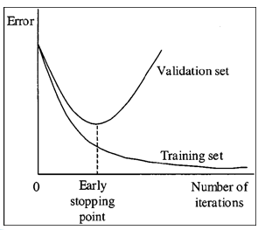
Early stopping
Use the validation data set to compute the loss function at the end of each training epoch, and once the loss stops decreasing, stop the training and use the test data to compute the final classification accuracy.
https://srdas.github.io/DLBook/ImprovingModelGeneralization.html

Slide 23
Question. If you have 10,000,000 examples, how would you split the train/dev/test set?
98% train , 1% dev , 1% test
33% train , 33% dev , 33% test
60% train , 20% dev , 20% test
80% train , 10% dev , 10% test

Slide 24
Question. If you have 10,000,000 examples, how would you split the train/dev/test set?
98% train , 1% dev , 1% test
33% train , 33% dev , 33% test
60% train , 20% dev , 20% test
80% train , 10% dev , 10% test

Slide 25
Question. The dev and test set should:
Come from the same distribution
Come from different distributions
Be identical to each other (same (x,y) pairs)
Have the same number of examples

Slide 26
Question. The dev and test set should:
Come from the same distribution
Come from different distributions
Be identical to each other (same (x,y) pairs)
Have the same number of examples

Slide 27
Question. If your Neural Network model seems to have high bias, what of the following would be promising things to try? (Check all that apply.)
Get more training data
Add regularization
Make the Neural Network deeper
Increase the number of units in each hidden layer
Get more test data

Slide 28
Question. If your Neural Network model seems to have high bias, what of the following would be promising things to try? (Check all that apply.)
Get more training data
Add regularization
Make the Neural Network deeper
Increase the number of units in each hidden layer
Get more test data

Slide 29
Question. You are working on an automated check-out kiosk for a supermarket, and are building a classifier for apples, bananas and oranges. Suppose your classifier obtains a training set error of 0.5%, and a dev set error of 7%.
Which of the following are promising things to try to improve your classifier? (Check all that apply.)
Increase the regularization parameter lambda
Decrease the regularization parameter lambda
Get more training data
Use a bigger neural network

Slide 30
Question. You are working on an automated check-out kiosk for a supermarket, and are building a classifier for apples, bananas and oranges. Suppose your classifier obtains a training set error of 0.5%, and a dev set error of 7%.
Which of the following are promising things to try to improve your classifier? (Check all that apply.)
Increase the regularization parameter lambda
Decrease the regularization parameter lambda
Get more training data
Use a bigger neural network

Slide 31
Question. What is weight decay?
The process of gradually decreasing the learning rate during training.
A technique to avoid vanishing gradient by imposing a ceiling on the values of the weights.
Gradual corruption of the weights in the neural network if it is trained on noisy data.
A regularization technique (such as L2 regularization) that results in gradient descent shrinking the
weights on every iteration.

Slide 32
Question. What is weight decay?
The process of gradually decreasing the learning rate during training.
A technique to avoid vanishing gradient by imposing a ceiling on the values of the weights.
Gradual corruption of the weights in the neural network if it is trained on noisy data.
A regularization technique (such as L2 regularization) that results in gradient descent shrinking the weights on every iteration.

Slide 33
Question. What happens when you increase the regularization hyperparameter lambda?
Weights are pushed toward becoming smaller (closer to 0)
Weights are pushed toward becoming bigger (further from 0)
Doubling lambda should roughly result in doubling the weights
Gradient descent taking bigger steps with each iteration (proportional to lambda)

Slide 34
Question. What happens when you increase the regularization hyperparameter lambda?
Weights are pushed toward becoming smaller (closer to 0)
Weights are pushed toward becoming bigger (further from 0)
Doubling lambda should roughly result in doubling the weights
Gradient descent taking bigger steps with each iteration (proportional to lambda)

Slide 35
Question. With the inverted dropout technique, at test time:
You do not apply dropout (do not randomly eliminate units), but keep the 1/keep_prob factor in the calculations used in training.
You apply dropout (randomly eliminating units) and do not keep the 1/keep_prob factor in the calculations used in training
You do not apply dropout (do not randomly eliminate units) and do not keep the 1/keep_prob factor in the calculations used in training
You apply dropout (randomly eliminating units) but keep the 1/keep_prob factor in the calculations used in training.

Slide 36
Question. With the inverted dropout technique, at test time:
You do not apply dropout (do not randomly eliminate units), but keep the 1/keep_prob factor in the calculations used in training.
You apply dropout (randomly eliminating units) and do not keep the 1/keep_prob factor in the calculations used in training
You do not apply dropout (do not randomly eliminate units) and do not keep the 1/keep_prob factor in the calculations used in training
You apply dropout (randomly eliminating units) but keep the 1/keep_prob factor in the calculations used in training.

Slide 37
Question. Increasing the parameter keep_prob from (say) 0.5 to 0.6 will likely cause the following: (Check the two that apply)
Increasing the regularization effect
Reducing the regularization effect
Causing the neural network to end up with a higher training set error
Causing the neural network to end up with a lower training set error

Slide 38
Question. Increasing the parameter keep_prob from (say) 0.5 to 0.6 will likely cause the following: (Check the two that apply)
Increasing the regularization effect
Reducing the regularization effect
Causing the neural network to end up with a higher training set error
Causing the neural network to end up with a lower training set error

Slide 39
Normalizing inputs

Slide 40
Normalizing training sets
$$x=\left[\begin{aligned}x1 \\ x2\end{aligned}\right]$$
$x_{2}$
$x_{2}$
$$3$$
$x_{2}$
$x_{1}$
$x_{1}$
$x_{1}$
$$5$$
Subtract mean:
$$μ=\frac{1}{m}\sum_{i=1}^{m}{x^{(i)}}$$
$$x≔x−μ$$
Normalize variance:
$$σ^{2}=\frac{1}{m}\sum_{i=1}^{m}{x^{(i)}∗∗2}$$
$$x=x/σ^{2}$$
Use same $μ$ and $σ^{2}$ to normalize test set

Slide 41
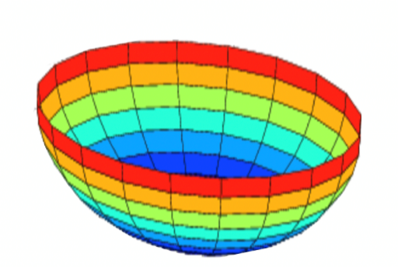
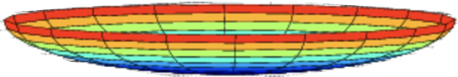

Why normalize inputs?
$$J\left(w,b\right)=\frac{1}{m}$$
$$\sum_{i=1}^{m}{ }$$
$$ℒ ({\hat{y}}^{\left(i\right)},y^{(i)})$$
Unnormalized:
Normalized:
$$J$$
$$J$$
$$w$$
$$w$$
$$b$$
$$b$$
$$b$$
$$b$$
$$w$$
$$w$$

Slide 42
Vanishing/exploding gradients
$x_{1}$
$$\hat{y}$$
$x_{2}$
=
a
w > I
w < I
$$Z^{[1]}=W^{[1]}X+b^{[1]}$$
$$A^{[1]}=g^{\left[1\right]}(Z^{\left[1\right]})$$
$$Z^{[2]}=W^{[2]}A^{[1]}+b^{[2]}$$
z
$$A^{[2]}=g^{\left[2\right]}(Z^{\left[2\right]})$$
…
$$A^{[L]}=g^{\left[L\right]}\left(Z^{\left[L\right]}\right)=\hat{Y}$$

Slide 43
Weight initialization for Deep Neural Networks

Slide 44
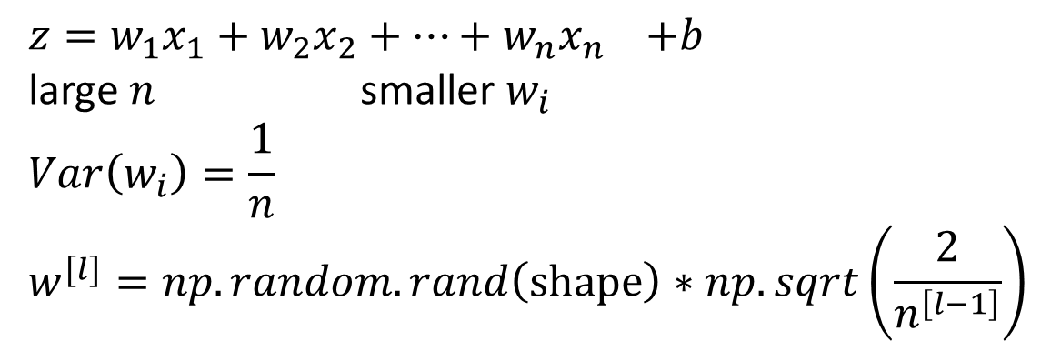
Single neuron example (Initialization)
$x_{1}$
$$a^{[l]}$$
Other variants:
$$\tanh{ \sqrt{\frac{1}{n^{[l−1]}}}}$$
$x_{2}$
$$\hat{y}$$
$x_{3}$
$x_{4}$
$$a=g(z)$$
$z=w_{1}x_{1}+w_{2}x_{2}+…+w_{n}x_{n}$ $+b$
large $n$ smaller $w_{i}$
$$Var\left(w_{i}\right)=\frac{1}{n}$$
$$w^{[l]}=np.random.rand\left(shape\right)∗np.sqrt\left(\frac{2}{n^{\left[l−1\right]}}\right)$$
Xavier initialization
$$\sqrt{\frac{2}{n^{[l−1]}+n^{[l]}}}$$
$$\frac{2}{n}$$
ReLU
$$g^{\left[l\right]}\left(z\right)=ReLU(z)$$

Slide 45
Gradient Checking

Slide 46
Forward and backward propagation
For example the first activation functions could be ReLU and the last one
Could be sigmoid
$$Z^{[1]}=W^{[1]}X+b^{[1]}$$
$${dZ}^{[L]}=A^{[L]}−Y$$
$$A^{[1]}=g^{\left[1\right]}(Z^{\left[1\right]})$$
$$dW^{[L]}=\frac{1}{m}dZ^{\left[L\right]}A^{{\left[L\right]}^{T}}$$
$$Z^{[2]}=W^{[2]}A^{[1]}+b^{[2]}$$
$$db^{[L]}=\frac{1}{m}np. sum(dZ^{\left[L\right]},axis=1, keepdims=True)$$
$$A^{[2]}=g^{\left[2\right]}(Z^{\left[2\right]})$$
…
$${dZ}^{[L−1]}=dW^{{\left[L\right]}^{T}}dZ^{\left[L\right]}{g^{′}}^{\left[L\right]}(Z^{\left[L−1\right]})$$
$$A^{[L]}=g^{\left[L\right]}\left(Z^{\left[L\right]}\right)=\hat{Y}$$
…
$${dZ}^{[1]}=dW^{{\left[L\right]}^{T}}dZ^{\left[2\right]}{g^{′}}^{\left[1\right]}(Z^{\left[1\right]})$$
$$dW^{[1]}=\frac{1}{m}dZ^{\left[1\right]}A^{{\left[1\right]}^{T}}$$
$$db^{[1]}=\frac{1}{m}np. sum(dZ^{\left[1\right]},axis=1, keepdims=True)$$
Align left/vertical will mess up the equations here

Slide 47
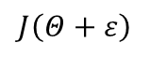
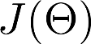
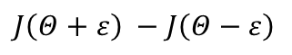
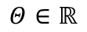
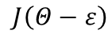
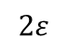
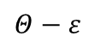
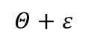
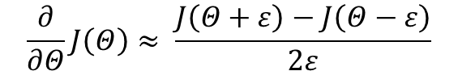
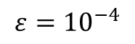
Numerical estimation of gradients

Slide 48
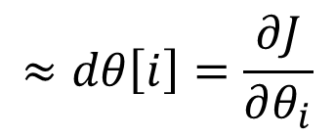
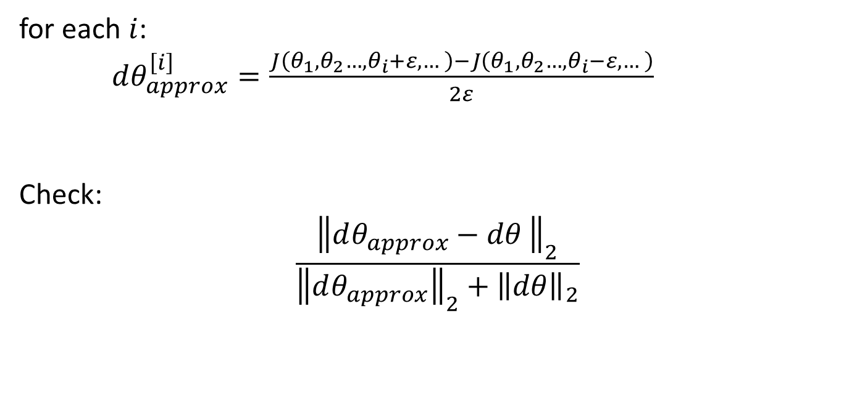
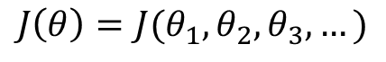
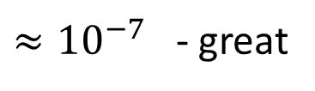
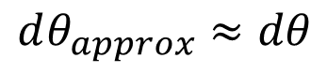
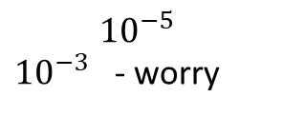
Gradient checking (Grad check)
Take $W^{\left[1\right]},b^{[1]},…,W^{\left[L\right]},b^{\left[L\right]}$ and reshape into a big vector $θ.$
Take ${dW}^{\left[1\right]},{db}^{[1]},…,{dW}^{\left[L\right]},{db}^{\left[L\right]}$ and reshape into a big vector $dθ.$
$$J\left(θ\right)=J(θ_{1},θ_{2},θ_{3},…)$$
for each $i$:
$dθ_{approx}^{\left[i\right]}=\frac{J\left(θ_{1},θ_{2}…,θ_{i}+ε,…\right)−J\left(θ_{1},θ_{2}…,θ_{i}−ε,…\right)}{2ε}$
Check:
$$\frac{{\left\|dθ_{approx}−dθ \right\|}_{2}}{{\left\|dθ_{approx}\right\|}_{2}+{\left\|dθ\right\|}_{2}}$$
$$≈dθ\left[i\right]=\frac{∂J}{∂θ_{i}}$$
$≈{10}^{−7}$ - great
$$dθ_{approx}≈dθ$$
$${10}^{−5}$$
${10}^{−3}$ - worry

Slide 49
Gradient checking implementation notes
- Don’t use in training – only to debug
- If algorithm fails grad check, look at components to try to identify bug.
- Remember regularization.
- Doesn’t work with dropout.
- Run at random initialization; perhaps again after some training.

Slide 50
Question. Why do we normalize the inputs ?
Normalization is another word for regularization--It helps to reduce variance
It makes the parameter initialization faster
It makes the cost function faster to optimize
It makes it easier to visualize the data

Slide 51
Question. Why do we normalize the inputs ?
Normalization is another word for regularization--It helps to reduce variance
It makes the parameter initialization faster
It makes the cost function faster to optimize
It makes it easier to visualize the data

Slide 52
Question. Which of these techniques are useful for reducing variance (reducing overfitting)? (Check all that apply.)
Dropout
Xavier initialization
Vanishing gradient
L2 regularization
Data augmentation
Exploding gradient
Gradient Checking

Slide 53
Question. Which of these techniques are useful for reducing variance (reducing overfitting)? (Check all that apply.)
Dropout
Xavier initialization
Vanishing gradient
L2 regularization
Data augmentation
Exploding gradient
Gradient Checking

Slide 54
Reading materials.
Machine Learning yearning. Andrew Ng. 2018.
https://www.deeplearning.ai/machine-learning-yearning/
Nitish Srivastava, et. al. Dropout: A Simple Way to Prevent Neural Networks from Overfitting

